Slide 1
Complexity
Lecture -13

Slide 2
Learning outcomes
At the end of this topic students should be able to:
Describe the key properties of NP-complete problems
Recognise the power of non-determinism
Identify ways of approximating solutions for intractable problems

Slide 3
Time Complexity
Common orders of complexity are:
O(1) = constant
O(log_{a}n) = logarithmic
O(n) = linear
O(n log_{a}n) = “n log n”
O(n²) = quadratic
O(n³) = cubic
O(n^{r}) = polynomial
O(a^{n}) = exponential
O(n!) = factorial
Refer Source: http://bigocheatsheet.com/

Slide 4
Time Complexity
The complexity of a problem is measured by the most efficient solution to it.
Polynomial Time
A problem is decidable in polynomial time if there is a program which solves the problem with time complexity O(n^{r}) for some r. The class of all such problems is denoted as ℘.
Generally, it is considered that any problem outside ℘ is intractable.

Slide 5
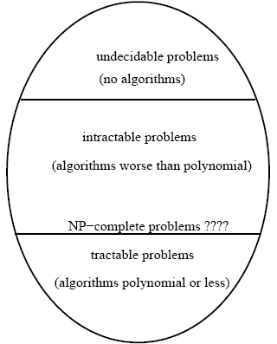
Algorithm Classes

Slide 6
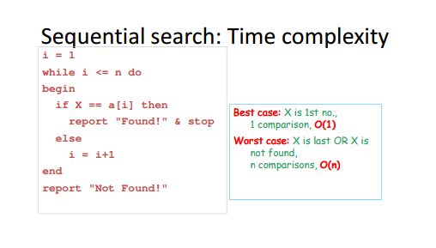
Time Complexity

Slide 7
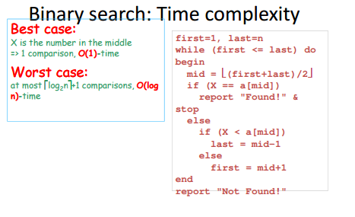
Time Complexity

Slide 8
Nondeterministic algorithms
An algorithm is nondeterministic if it makes an unspecified choice at some point
For e.g. a non-deterministic TM (NTM) may have a set of rules that prescribes more than one action for a given situation

Slide 9
Nondeterministic complexity
Nondeterministic algorithms can have complexities which appear much lower than deterministic algorithms
Example: Is n prime?
Deterministic algorithm:
test all numbers 2,3,4.... n-1 as divisors of n
what is the complexity?
O(n), as we may test all such numbers and find that none of them divide n
Notes:
Complexity O(n)

Slide 10
Nondeterministic complexity
Nondeterministic algorithms:
test all numbers 2,3,4... n-1 as divisors of n
if one or more numbers is a divisor, result is false. Else result is true.
time complexity is cost of checking an answer - i.e O(1) rather than finding one
However, it’s generally not feasible to execute a large number of options
Notes:
Complexity O(n)

Slide 11
NP Problems
Polynomial time problems:
solution found in polynomial time on a deterministic TM
If a problem has nondeterministicly generated 'solutions' that can be checked in polynomial time, it is called an NP problem (Nondeterministic Polynomial)
Examples
Satisfiability Problem
Traveling Salesman Problem
Hamiltonian Circuit Problem

Slide 12
Key idea
A problem is in NP if a proposed solution to it can be checked in polynomial time.

Slide 13
A Problem in NP - Satisfiability Problem
Boolean variable - values 0 or 1.
Clause is a disjunction of variables or their negations.
For example, are clauses.
A formula is in conjunctive normal form
u1 Λ u2 Λ . . . Λ u_{n} where each ui is a clause.

Slide 14
NP Completeness
Some NP problems have a special property:
they can be converted/reduced, in polynomial time, to any other NP problem!
These special NP problems are called NP-Complete
NP-complete problems have solutions which can be checked in polynomial time
cannot necessarily be found in polynomial time
stand or fall together (i.e. either all exponential or all polynomial)
Border between tractable and intractable
science is unsure if they are in ℘ (suspect not)
Current known number of NP-complete problems is > 1000

Slide 15
Problems in P
Sorting
linear programming
primality testing
matrix inversion
greatest common divisor, ...
tractable!

Slide 16
Problems in NP
Travelling salesman,
Hamiltonian circuit,
vertex cover,
3-satisability,
graph coloring, Sub-graph isomorphism,
clique problem, knapsack problem, bin packing,
serializability of database history,
normal form violation,
job scheduling, timetabling, integer programming,
mastermind, minesweeper,
Petri net reachability,
presentation of finite groups,
+ several thousand others ...
intractable!

Slide 17
NP Problems
Existing Solutions
Approximation algorithms
Settle for sub-optimal solution
Heuristic algorithms
Probabilistic solution but not certain, Probably efficient
Randomized algorithms
Random choices, Probably correct
Genetic algorithms
Applied when exhaustive search is hard
Modeled on human genetics

